Slide 1


OCP 11 [1Z0-819]
Dr.-Ing Mohamed Amine Mezghich
Associate Professor at ENSI, CEO of Smart IT Partner
JAVA/J2EE Certified Trainer
ma.mezghich@smart-it-partner.com
amine.mezghich@ensi-uma.tn

Slide 2
Chapter 9 : Exceptions and Assertions
The OCP exam topics covered in this chapter include the following: ✓ Exceptions and Assertions ■ Use try-catch and throw statements ■ Use catch, multi-catch, and finally clauses ■ Use Autoclose resources with a try-with-resources statement ■ Create custom exceptions and Auto-closeable resources ■ Test invariants by using assertions

Slide 3
Chapter 9 : Exceptions and Assertions
You have already learned the basics of exceptions for the OCA.
While reviewing these basics, we will point out the additional exception classes that you are expected to know for the OCP.
We will also cover the more advanced features introduced in Java 7 for working with exceptions. We will end the chapter by introducing assertions.

Slide 4
1-Reviewing Exceptions
A program can fail for just about any reason. Here are just a few of the possibilities for program failure that are commonly covered on the OCP exam: ■ Your program tries to read a file that doesn’t exist. ■ Your program tries to access a database, but the network connection to the database is unavailable. ■ You made a coding mistake and wrote an invalid SQL statement in your JDBC code. ■ You made a coding mistake and used the wrong format specifiers when using DateTimeFormatter.

Slide 5
1-Reviewing Exceptions
As you can see, some of these are coding mistakes. Others are completely beyond your control. Your program can’t help it if the network connection goes down. What it can do is deal with the situation.
We will cover the key terms used with exceptions, syntax, and rules for working with exceptions. We will also let you know which exception classes you should be familiar with.

Slide 6
1-Reviewing Exceptions
1-1)Exceptions Terminology An exception is Java’s way of saying, “I give up. I don’t know what to do right now. You deal with it.”

Slide 7
1-Reviewing Exceptions
1-2) Categories of Exceptions Figure 6.1 reviews the hierarchy of these classes. Remember that a runtime exception, or unchecked exception, may be caught, but it is not required that it be caught. After all, if you had to check for NullPointerException, every piece of code that you wrote would need to deal with it.
A checked exception is any class that extends Exception but is not a runtime exception. Checked exceptions must follow the handle or declare rule where they are either caught or thrown to the caller. An error is fatal and should not be caught by the program. While it is legal to catch an error, it is not a good practice.

Slide 8
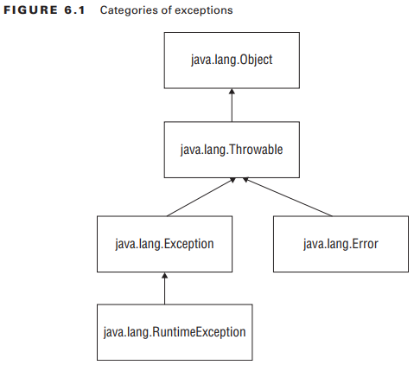
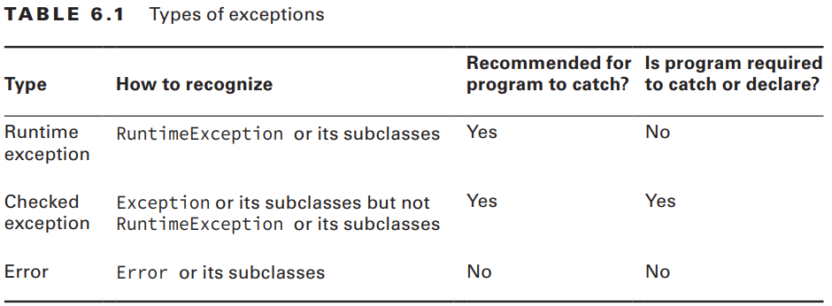
1-Reviewing Exceptions
1-2) Categories of Exceptions

Slide 9
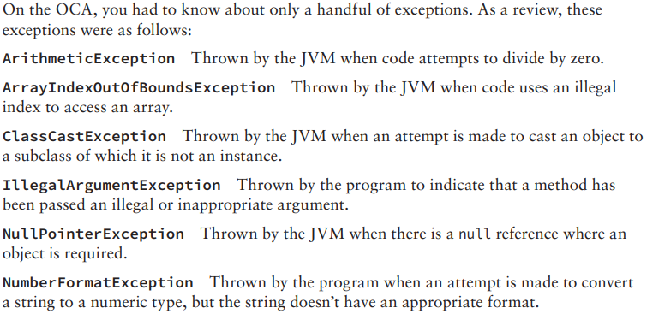
1-Reviewing Exceptions
1-3) Exceptions on the OCP
You also learned that java.io.IOException is an example of a checked exception. This made it easier, because the exam needed to tell you when an exception was a checked exception other than an IOException.

Slide 10
1-Reviewing Exceptions
1-3) Exceptions on the OCP On the OCP, you need to know more exceptions. The objectives cover a number of APIs that throw a mix of checked and unchecked exceptions.
Table 6.2 and Table 6.3 provide a summary of the checked and runtime exceptions that you need to know for the exam.
It’s OK if you don’t know what all of these do yet. Just remember that IO, parsing, and SQL exceptions are checked.
Anything else is a runtime exception unless the exam states otherwise. You can come back to this later for review.

Slide 11
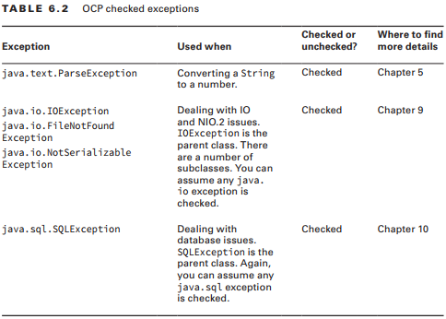
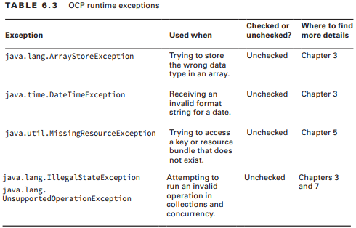
1-Reviewing Exceptions
1-3) Exceptions on the OCP

Slide 12
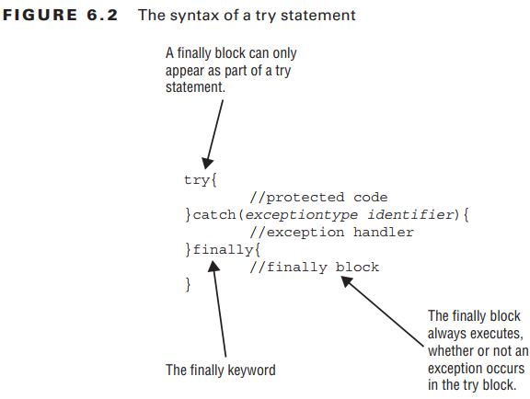
1-Reviewing Exceptions
1-4) Try Statement
The try statement consists of a mandatory try clause.
It can include one or more catch clauses to handle the exceptions that are thrown.
It can also include a finally clause, which runs regardless of whether an exception is thrown.
This is all still true for both try statements and try-with-resources statements.

Slide 13
1-Reviewing Exceptions
1-4) Try Statement There is also a rule that says a try statement is required to have either or both of the catch and finally clauses. This is true for try statements, but is not true for try-with-resources statements, as you’ll see later in the chapter. There are two other rules that you need to remember from the OCA about the catch clauses: ■ Java checks the catch blocks in the order in which they appear. It is illegal to declare a subclass exception in a catch block that is lower down in the list than a superclass exception because it will be unreachable code. ■ Java will not allow you to declare a catch block for a checked exception (ex : IOException) type that cannot potentially be thrown by the try clause body. This is again to avoid unreachable code.

Slide 14

1-Reviewing Exceptions
1-5) Throw vs. Throws The exam might test whether you are paying attention to the difference between throw and throws. Remember that throw means an exception is actually being thrown and throws indicate that the method merely has the potential to throw that exception. The following example uses both:

Slide 15
2-Creating Custom Exceptions
Sometimes, you want to write a method with a more specialized type of exception. You can create your own exception class to do this.
When creating your own exception, you need to decide whether it should be a checked or unchecked exception.
While you can extend any exception class, it is most common to extend Exception (for checked) or RuntimeException (for unchecked.)

Slide 16
2-Creating Custom Exceptions
Creating your own exception class is really easy. Can you figure out whether the exceptions are checked or unchecked in this example? 1: class CannotSwimException extends Exception {} 2: class DangerInTheWater extends RuntimeException {} 3: class SharkInTheWaterException extends DangerInTheWater {} 4: class Dolphin { 5: public void swim() throws CannotSwimException { 6: // logic here 7: } 8: }

Slide 17
2-Creating Custom Exceptions
On line 1, we have a checked exception because it extends directly from Exception.
On line 2, we have an unchecked exception because it extends directly from RuntimeException.
On line 3, we have another unchecked exception because it extends indirectly from RuntimeException.
Lines 5–7 are a method that declares it might throw the checked CannotSwimException. The method implementation could be written to actually throw it or not. The method implementation could also be written to throw a SharkInTheWaterException, an ArrayIndexOutOfBoundsException, or any other runtime exception.

Slide 18
2-Creating Custom Exceptions
Let’s see how to pass more information in your exception. The following example shows the three most common constructors defined by the Exception class: public class CannotSwimException extends Exception { public CannotSwimException() { super(); } public CannotSwimException(Exception e) { super(e); } public CannotSwimException(String message) { super(message); } }

Slide 19
2-Creating Custom Exceptions
The first constructor is the default constructor with no parameters. The second constructor shows how to wrap another exception inside yours. The third constructor shows how to pass a custom error message.
Using a different constructor allows you to provide more information about what went wrong.
We would get output like this if we wrote a main method with the line throw new CannotSwimException();:

Slide 20
2-Creating Custom Exceptions
The first constructor is the default constructor with no parameters. The second constructor shows how to wrap another exception inside yours. The third constructor shows how to pass a custom error message.
Using a different constructor allows you to provide more information about what went wrong.
We would get output like this if we wrote a main method with the line
throw new CannotSwimException();:

Slide 21
2-Creating Custom Exceptions
Exception in thread "main" CannotSwimException at CannotSwimException.main(CannotSwimException.java:18) This gives us just the exception and location. Now we change the main method to wrap an exception using the line
throw new CannotSwimException(new RuntimeException());
Exception in thread "main" CannotSwimException: java.lang.RuntimeException at CannotSwimException.main(CannotSwimException.java:19) Caused by: java.lang.RuntimeException ... 1 more This time, we find the underlying RuntimeException as well.

Slide 22
2-Creating Custom Exceptions
Finally, we change the main method to pass a message using the line
throw new CannotSwimException("broken fin");
Exception in thread "main" CannotSwimException: broken fin at CannotSwimException.main(CannotSwimException.java:20) This time we see the message text in the result. You might want to provide more information about the exception depending on the problem.

Slide 23
2-Creating Custom Exceptions
The error messages that we’ve been showing are called a stack trace. They show the exception along with the method calls it took to get there. Java automatically prints the stack trace when the program handles an exception. You can also print the stack trace on your own: try { throw new CannotSwimException(); } catch (CannotSwimException e) { e.printStackTrace(); }

Slide 24
3-Using Multi-catch
When something goes wrong in a program, it is common to log the error and convert it to a different exception type. In this example, we print the stack trace rather than write to a log. Next, we throw a runtime exception: 2: public static void main(String[] args) { 3: try { 4: Path path = Paths.get("dolphinsBorn.txt"); 5: String text = new String(Files.readAllBytes(path)); 6: LocalDate date = LocalDate.parse(text); 7: System.out.println(date); 8: } catch (DateTimeParseException e) { 9: e.printStackTrace(); 10: throw new RuntimeException(e); 11: } catch (IOException e) { 12: e.printStackTrace(); 13: throw new RuntimeException(e); 14: } }

Slide 25
3-Using Multi-catch
Lines 4 and 5 read a text file into a String. We cover this in Chapter 9, “NIO.2.” For now, it does what it sounds like and throws an IOException if the operation fails. Line 6 converts that String to a LocalDate. You saw in Chapter 5, “Dates, Strings, and Localization,” that this throws a DateTimeParseException on failure. The two catch blocks on lines 8–14 print a stack trace and then wrap the exception in a RuntimeException.
This works. However, duplicating code is bad. Think about what happens if we decide that we want to change the code to write to a log file instead of printing the stack trace. We have to be sure to change the code in two places. Before Java 7, there were two approaches to deal with this problem. One was to catch Exception instead of the specific types:

Slide 26
3-Using Multi-catch
public static void main(String[] args) { try { Path path = Paths.get("dolphinsBorn.txt"); String text = new String(Files.readAllBytes(path)); LocalDate date = LocalDate.parse(text); System.out.println(date); } catch (Exception e) { // BAD approach e.printStackTrace(); throw new RuntimeException(e); } } The duplicate code is gone. However, this isn’t a good approach because it catches other exceptions too.

Slide 27
3-Using Multi-catch
The other approach is to extract the duplicate code into a helper method: public static void main(String[] args) { try { Path path = Paths.get("dolphinsBorn.txt"); String text = new String(Files.readAllBytes(path)); LocalDate date = LocalDate.parse(text); System.out.println(date); } catch (DateTimeParseException e) { handleException(e); } catch (IOException e) { handleException(e); } } private static void handleException(Exception e) { e.printStackTrace(); throw new RuntimeException(e); }

Slide 28
3-Using Multi-catch
Now we have an elegant solution to the problem: public static void main(String[] args) { try { Path path = Paths.get("dolphinsBorn.txt"); String text = new String(Files.readAllBytes(path)); LocalDate date = LocalDate.parse(text); System.out.println(date); } catch (DateTimeParseException | IOException e) { e.printStackTrace(); throw new RuntimeException(e); } } This is much better. There’s no duplicate code, the common logic is all in one place, and the logic is exactly where we would expect to find it.

Slide 29
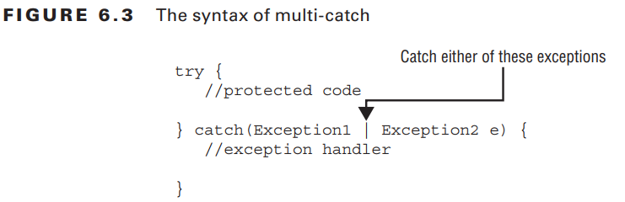
3-Using Multi-catch
Figure 6.3 shows the syntax of multi-catch. It’s like a regular catch clause, except two or more exception types are specified separated by a pipe. The pipe is also used as the “or” operator, making it easy to remember that you can use either/or of the exception types. Notice how there is only one variable name in the catch clause. Java is saying that the variable named e can be of type Exception1 or Exception2.

Slide 30
3-Using Multi-catch
The exam might try to trick you with invalid syntax. Remember that the exceptions can be listed in any order within the catch clause. However, the variable name must appear only once and at the end.
Do you see why these are valid or invalid? catch(Exception1 e | Exception2 e | Exception3 e) // DOES NOT COMPILE catch(Exception1 e1 | Exception2 e2 | Exception3 e3) // DOES NOT COMPILE catch(Exception1 | Exception2 | Exception3 e)

Slide 31
3-Using Multi-catch
Java intends multi-catch to be used for exceptions that aren’t related, and it prevents you from specifying redundant types in a multi-catch. Do you see what is wrong here? try { throw new IOException(); } catch (FileNotFoundException | IOException e) { } // DOES NOT COMPILE FileNotFoundException is a subclass of IOException. Specifying it in the multi-catch is redundant, and the compiler gives a message such as this: The exception FileNotFoundException is already caught by the alternative IOException
The correct code is as follows: try { throw new IOException(); } catch (IOException e) { }

Slide 32
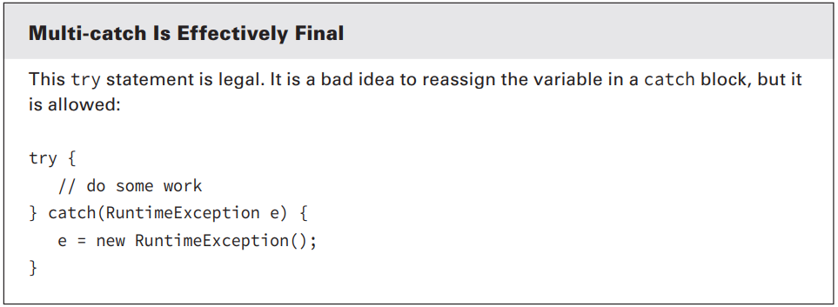
3-Using Multi-catch

Slide 33
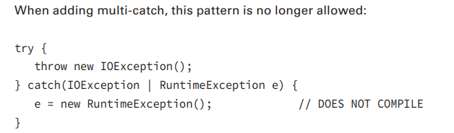
3-Using Multi-catch

Slide 34
3-Using Multi-catch
To review multi-catch, see how many errors you can find in this try statement. 11: public void doesNotCompile() { // METHOD DOES NOT COMPILE 12: try { 13: mightThrow(); 14: } catch (FileNotFoundException | IllegalStateException e) { 15: } catch (InputMismatchException e | MissingResourceException e) { 16: } catch (SQLException | ArrayIndexOutOfBoundsException e) { 17: } catch (FileNotFoundException | IllegalArgumentException e) { 18: } catch (Exception e) { 19: } catch (IOException e) { 20: } 21: } 22: private void mightThrow() throws DateTimeParseException, IOException { }

Slide 35
3-Using Multi-catch
Line 15 has an extra variable name. Remember that there can be only one exception variable per catch block.
Line 18 and 19 are reversed. The more general superclasses must be caught after their subclasses. While this doesn’t have anything to do with multi-catch, you’ll see “regular” catch block problems mixed in with multi-catch.
Line 17 cannot catch FileNotFoundException because that exception was already caught on line 14. You can’t list the same exception type more than once in the same try statement, just like with “regular” catch blocks.
Line 16 cannot catch SQLException because nothing in the try statement can potentially throw one. Don’t worry—you won’t see this many problems in the same example on the exam!

Slide 36
4-Using Try-With-Resources
As you’ll see in Chapters 8, 9, and 10, it is important to close resources when you are finished with them. For the exam, a resource is typically a file or database. Prior to Java 7, your code would look like the following. 10: public void oldApproach(Path path1, Path path2) throws IOException { 11: BufferedReader in = null; 12: BufferedWriter out = null; 13: try { 14: in = Files.newBufferedReader(path1); 15: out = Files.newBufferedWriter(path2); 16: out.write(in.readLine()); 17: } finally { 18: if (in != null) in.close(); 19: if (out != null) out.close(); 20: } 21: }

Slide 37
4-Using Try-With-Resources
Switching to the try-with-resources syntax introduced in Java 7, it can be rewritten as follows: 30: public void newApproach(Path path1, Path path2) throws IOException { 31: try (BufferedReader in = Files.newBufferedReader(path1); 32: BufferedWriter out = Files.newBufferedWriter(path2)) { 33: out.write(in.readLine()); 34: } 35: }

Slide 38
4-Using Try-With-Resources
There is no longer code just to close resources. The new try-with-resources statement automatically closes all resources opened in the try clause. This feature is also known as automatic resource management, because Java automatically takes care of the closing.

Slide 39
4-Using Try-With-Resources
4-1) Try-With-Resources Basics You might have noticed that there is no finally block in the try-with-resources code. For the OCA exam, you learned that a try statement must have one or more catch blocks or a finally block. This is still true. The finally clause exists implicitly. You just don’t have to type it.
Figure 6.4 shows what a try-with-resources statement looks like. Notice that one or more resources can be opened in the try clause. Also, notice that parentheses are used to list those resources and semicolons are used to separate the declarations. This works just like declaring multiple indexes in a for loop.

Slide 40
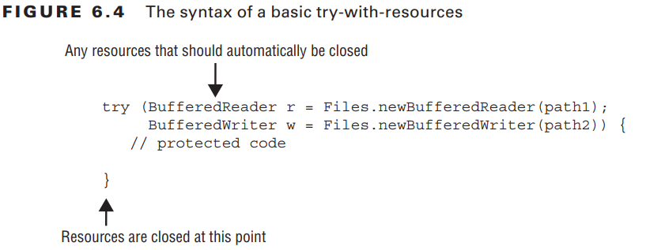
4-Using Try-With-Resources
4-1) Try-With-Resources Basics

Slide 41
4-Using Try-With-Resources
4-1) Try-With-Resources Basics Figure 6.5 shows that a try-with-resources statement is still allowed to have catch and/ or finally blocks. They are run in addition to the implicit one. The implicit finally block runs before any programmer-coded ones.

Slide 42
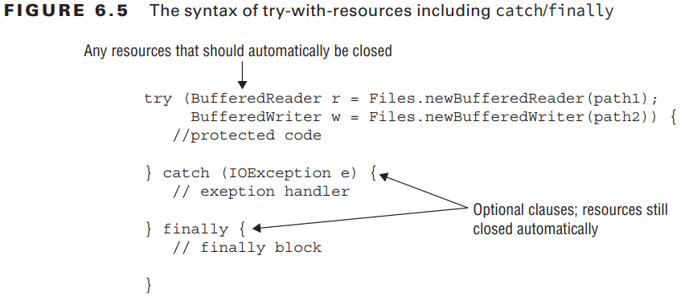
4-Using Try-With-Resources
4-1) Try-With-Resources Basics

Slide 43
4-Using Try-With-Resources
4-1) Try-With-Resources Basics To make sure that you’ve wrapped your head around the differences, make sure you can fill in Table 6.4 and Table 6.5 with whichever combinations of catch and finally blocks are legal configurations.

Slide 44
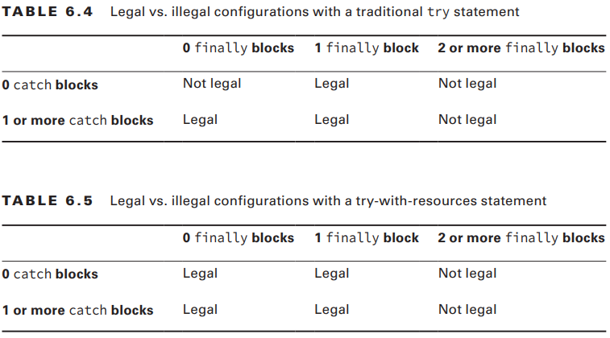
4-Using Try-With-Resources
4-1) Try-With-Resources Basics

Slide 45
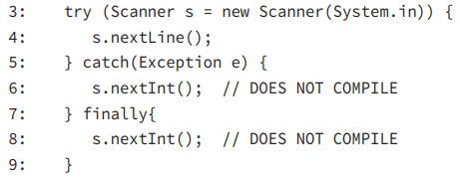
4-Using Try-With-Resources
4-1) Try-With-Resources Basics The resources created in the try clause are only in scope within the try block. This is another way to remember that the implicit finally runs before any catch/finally blocks that you code yourself. The implicit close has run already, and the resource is no longer available. Do you see why lines 6 and 8 don’t compile in this example?

Slide 46
4-Using Try-With-Resources
4-1) Try-With-Resources Basics The problem is that Scanner has gone out of scope at the end of the try clause. Lines 6 and 8 do not have access to it. This is actually a nice feature. You can’t accidentally use an object that has been closed.
In a traditional try statement, the variable has to be declared before the try statement so that both the try and finally blocks can access it, which has the unpleasant side effect of making the variable in scope for the rest of the method, just inviting you to call it by accident.

Slide 47
4-Using Try-With-Resources
4-2) AutoCloseable You can’t just put any random class in a try-with-resources statement. Java commits to closing automatically any resources opened in the try clause. Here we tell Java to try to close the Turkey class when we are finished with it: public class Turkey { public static void main(String[] args) { try (Turkey t = new Turkey()) { // DOES NOT COMPILE System.out.println(t); } } } Java doesn’t allow this. It has no idea how to close a Turkey. Java informs us of this fact with a compiler error: The resource type Turkey does not implement java.lang.AutoCloseable

Slide 48
4-Using Try-With-Resources
4-2) AutoCloseable In order for a class to be created in the try clause, Java requires it to implement an interface called AutoCloseable. TurkeyCage does implement this interface: 1: public class TurkeyCage implements AutoCloseable { 2: public void close() { 3: System.out.println("Close gate"); 4: } 5: public static void main(String[] args) { 6: try (TurkeyCage t = new TurkeyCage()) { 7: System.out.println("put turkeys in"); 8: } 9: } 10: }

Slide 49
4-Using Try-With-Resources
4-2) AutoCloseable That’s much better. Line 1 declares that the class implements the AutoCloseable interface. This interface requires a close() method to be implemented, which is done on lines 2–4. Now, line 6 is allowed. Java does know how to close a TurkeyCage object. All Java has to do is to call the close() method. The AutoCloseable interface has only one method to implement: public void close() throws Exception;

Slide 50
4-Using Try-With-Resources
4-2) AutoCloseable Do you see any problems with it? public class StuckTurkeyCage implements AutoCloseable { public void close() throws Exception { throw new Exception("Cage door does not close"); } public static void main(String[] args) { try (StuckTurkeyCage t = new StuckTurkeyCage()) { // DOES NOT COMPILE System.out.println("put turkeys in"); } } }

Slide 51
4-Using Try-With-Resources
4-2) AutoCloseable The try-with-resources statement throws a checked exception. And you know that checked exceptions need to be handled or declared. Tricky isn’t it? This is something that you need to watch for on the exam. If the main() method declared an Exception, this code would compile.

Slide 52
4-Using Try-With-Resources
4-2) AutoCloseable Java strongly recommends that close() not actually throw Exception. It is better to throw a more specific exception. Java also recommends to make the close() method idempotent. Idempotent means that the method can called be multiple times without any side effects or undesirable behavior on subsequent runs. For example, it shouldn’t throw an exception the second time or change state or the like. Both these negative practices are allowed. They are merely discouraged

Slide 53
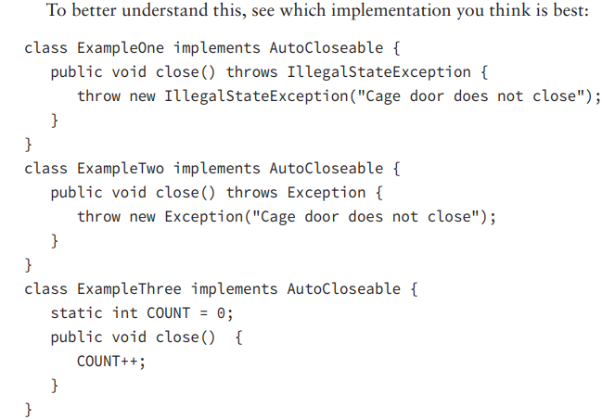
4-Using Try-With-Resources
4-2) AutoCloseable
Example One is the best implementation. ExampleTwo throws Exception rather than a more specifc subclass, which is not recommended. ExampleThree has a side effect. It changes the state of a variable. Side effects are not recommended.

Slide 54
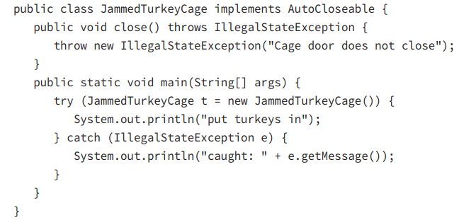
4-Using Try-With-Resources
4-3) Suppressed Exceptions The following shows how we can catch an exception thrown by close().

Slide 55
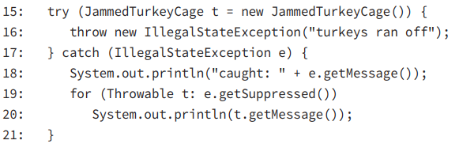
4-Using Try-With-Resources
4-3) Suppressed Exceptions What happens if the try block also throws an exception? Java 7 added a way to accumulate exceptions. When multiple exceptions are thrown, all but the first (toutes sauf la première)are called suppressed exceptions.

Slide 56
4-Using Try-With-Resources
4-3) Suppressed Exceptions Line 16 throws the primary exception. At this point, the try clause ends and Java automatically calls the close() method. It throws an IllegalStateException, which is added as a suppressed exception. Then line 17 catches the primary exception. Line 18 prints the message for the primary exception. Line 19 loops through the one suppressed exception and line 20 prints it out.
The output is caught: turkeys ran off Cage door does not close
Keep in mind that the catch block looks for matches on the primary exception

Slide 57
4-Using Try-With-Resources
4-3) Suppressed Exceptions What do you think this code prints? 22: try (JammedTurkeyCage t = new JammedTurkeyCage()) { 23: throw new RuntimeException("turkeys ran off"); 24: } catch (IllegalStateException e) { 25: System.out.println("caught: " + e.getMessage()); 26: }

Slide 58
4-Using Try-With-Resources
4-3) Suppressed Exceptions The primary exception is a RuntimeException. Since this does not match the catch clause, the exception is thrown to the caller. Eventually the main method would output something like the following: Exception in thread "main" java.lang.RuntimeException: turkeys ran off atJammedTurkeyCage.main(JammedTurkeyCage.java:20) Suppressed: java.lang.IllegalStateException: Cage door does not close atJammedTurkeyCage.close(JammedTurkeyCage.java:5) atJammedTurkeyCage.main(JammedTurkeyCage.java:21)

Slide 59
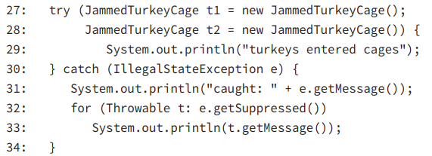
4-Using Try-With-Resources
4-3) Suppressed Exceptions Java remembers the suppressed exceptions that go with a primary exception even if we don’t handle them in the code. Now let’s look at what happens if two exceptions are thrown while closing resources:

Slide 60

4-Using Try-With-Resources
4-3) Suppressed Exceptions On line 29, the turkeys enter the cages without exception. Then Java tries to close both cages automatically. t2 is closed first, since Java closes resources in the reverse order from which it created them. This throws an exception.
Since it is the first exception to occur, it becomes the primary exception.
Then t1 is closed. Since an exception has already been thrown, this one becomes a suppressed exception. The output is

Slide 61
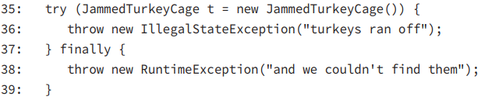
4-Using Try-With-Resources
4-3) Suppressed Exceptions Finally, keep in mind that suppressed exceptions apply only to exceptions thrown in the try clause. The following example does not throw a suppressed exception:

Slide 62
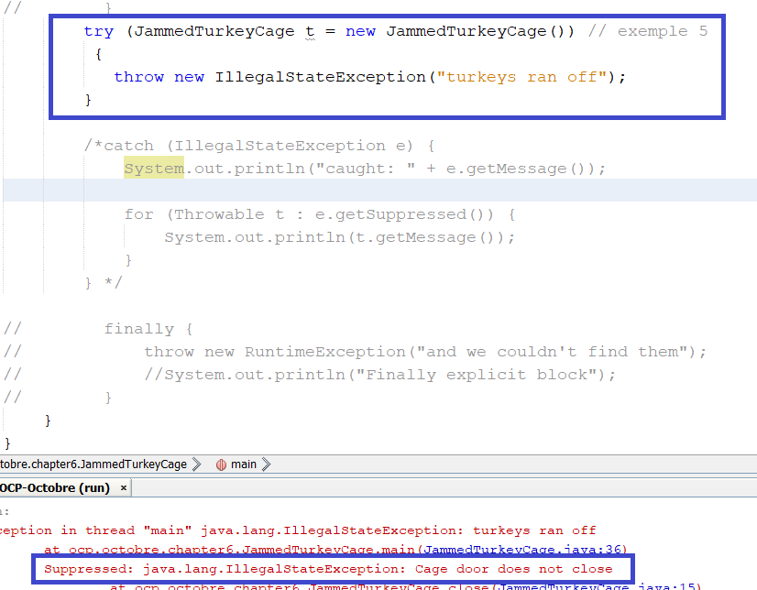
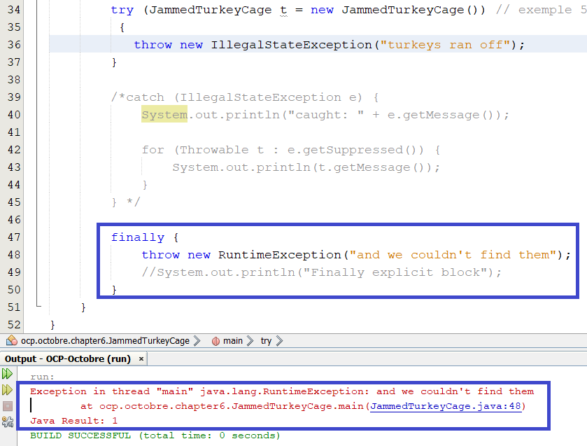
4-Using Try-With-Resources
4-3) Suppressed Exceptions

Slide 63
4-Using Try-With-Resources
4-3) Suppressed Exceptions Line 36 throws an exception. Then Java tries to close the resource and adds a suppressed exception to it. Now we have a problem. The finally block runs after all this. Since line 38 throws an exception, the previous exception is lost. This has always been and continues to be bad programming practice. We don’t want to lose exceptions.

Slide 64
4-Using Try-With-Resources
4-4) Putting It Together You’ve learned two new rules for the order in which code runs in a try-with-resources statement: ■ Resources are closed after the try clause ends and before any catch/finally clauses. ■ Resources are closed in the reverse order from which they were created. Based on these rules, can you figure out what this code prints?

Slide 65
4-Using Try-With-Resources
4-4) Putting It Together public class Auto implements AutoCloseable { int num; Auto(int num) { this.num = num; } public void close() { System.out.println("Close: " + num); } public static void main(String[] args) { try (Auto a1 = new Auto(1); Auto a2 = new Auto(2)) { throw new RuntimeException(); } catch (Exception e) { System.out.println("ex"); } finally { System.out.println("finally"); } } }
Since the resources are closed in the reverse order from which they were opened, we have Close: 2 and then Close: 1. After that, the catch block and finally block are run—just as they are in a regular try statement. The output is Close: 2 Close: 1 ex finally

Slide 66
5-Rethrowing Exceptions
Suppose that we have a method that declares two checked exceptions: public void parseData() throws SQLException, DateTimeParseException {} When calling this method, we need to handle or declare those two exception types. There are few valid ways of doing this. We could have two catch blocks and duplicate the logic. Or we could use multi-catch: 3: public void multiCatch() throws SQLException, DateTimeParseException { 4: try { 5: parseData(); 6: } catch (SQLException | DateTimeParseException e) { 7: System.err.println(e); 8: throw e; 9: } }

Slide 67
5-Rethrowing Exceptions
The list of exceptions in the catch block and the list of exceptions in the method signature of multiCatch() are the same. This is duplication. Since there were a number of changes in Java 7, the language designers decided to solve this problem at the same time. They made it legal to write Exception in the catch, The following code is similar to the preceding example: 3: public void rethrowing() throws SQLException, DateTimeParseException { 4: try { 5: parseData(); 6: } catch (Exception e) { 7: System.err.println(e); 8; throw e; 9: } }

Slide 68
5-Rethrowing Exceptions
This time, Java interprets Exception as the possible exceptions that can be thrown in the method. As long as all of these checked exceptions are handled or declared, Java is happy.

Slide 69
6-Working with Assertions
An assertion is a Boolean expression that you place at a point in your code where you expect something to be true.
Why assert something when you know it is true? It is only true when everything is working properly. If the program has a defect, it might not actually be true. Detecting this earlier in the process lets you know something is wrong.
In the following sections, we cover the syntax for using an assertion, how to turn them on/off, and common uses of assertions.

Slide 70
6-Working with Assertions
6-1) The assert Statement The syntax for an assert statement has two forms: assert boolean_expression; assert boolean_expression: error_message; The boolean expression must evaluate to true or false. It can be inside optional parenthesis. The optional error message is a String used as the message for the AssertionError that is thrown. That’s right. An assertion throws an AssertionError if it is false. Since programs aren’t supposed to catch an Error, this means that assertion failures are fatal and end the program.

Slide 71
6-Working with Assertions
6-1) The assert Statement The three possible outcomes (résultats)of an assert statement are as follows:
■ 1-If assertions are disabled, Java skips the assertion and goes on in the code. ■ 2-If assertions are enabled and the boolean expression is true, then our assertion has been validated and nothing happens. The program continues to execute in its normal manner. ■ 3-If assertions are enabled and the boolean expression is false, then our assertion is invalid and a java.lang.AssertionError is thrown.

Slide 72
6-Working with Assertions
6-1) The assert Statement Presuming assertions are enabled, an assertion is a shorter/better way of writing the following: if (!boolean_expression) throw new AssertionError(); The assert syntax is easier to read. But wait. Remember when we said a developer shouldn’t be throwing an Error? With the assert syntax, you aren’t. Java is throwing the Error!

Slide 73
6-Working with Assertions
6-1) The assert Statement Suppose that we enable assertions by running the following example with the command java –ea Assertions: 1: public class Assertions { 2: public static void main(String[] args) { 3: int numGuests = -5; 4: assert numGuests > 0; 5: System.out.println(numGuests); 6: } 7: }
1-Il faut editer le code
2-Compiler le code javac nomfichier .java
3-java –ea Assertions

Slide 74
6-Working with Assertions
6-1) The assert Statement We made a typo in the code. We intended for there to be five guests and not negative five guests. The assertion on line 4 detects this problem. Java throws the AssertionError at this point. Line 5 never runs since an error was thrown. The program ends with a stack trace similar to this: Exception in thread "main" java.lang.AssertionError at asserts.Assertions.main(Assertions.java:7)

Slide 75
6-Working with Assertions
6-2) Enabling Assertions By default, assert statements are ignored by the JVM at runtime. To enable assertions, use the -enableassertions ﬂag on the command line: java -enableassertions Rectangle You can also use the shortcut -ea ﬂag: java -ea Rectangle Using the -enableassertions or -ea ﬂag without any arguments enables assertions in all classes except system classes. System classes are classes that are part of the Java runtime. You can think of them as the classes that come with Java. You can also enable assertions for a specific class or package.

Slide 76
6-Working with Assertions
6-2) Enabling Assertions For example, the following command enables assertions only for classes in the com.wiley.demos package and any subpackages:
java -ea:com.wiley.demos... my.programs.Main The three dots means any class in the specified package or subpackages. You can also enable assertions for a specific class: java -ea:com.wiley.demos.TestColors my.programs.Main

Slide 77
6-Working with Assertions
6-2) Enabling Assertions You can disable assertions using the -disableassertions (or -da) ﬂag for a specific class or package that was previously enabled. For example, the following command enables assertions for the com.wiley.demos package but disables assertions for the TestColors class: java -ea:com.wiley.demos... -da:com.wiley.demos.TestColors my.programs.Main

Slide 78
6-Working with Assertions
6-3) Using Assertions You can use assertions for many reasons, including the following. You won’t be asked to identify the type of assertion on the exam. This is just to give you ideas of how they might be used. Internal Invariants You assert that a value is within a certain constraint. assert x < 0 is an example of an internal invariant. Class Invariants You assert the validity of an object’s state. Class invariants are typically private methods within the class that return a boolean. The upcoming Rectangle class demonstrates a class invariant. Control Flow Invariants You assert that a line of code you assume is unreachable is never reached. The upcoming TestSeasons class demonstrates a control ﬂow invariant. Preconditions You assert that certain conditions are met before a method is invoked. Post Conditions You assert that certain conditions are met after a method executes successfully.

Slide 79
6-Working with Assertions
6-3) Using Assertions The following example demonstrates a control ﬂow invariant. Suppose that we have the following enum declaration. Notice how winter is missing from the list of seasons. This is intentional. Our zoo is closed in the winter because it is too cold for visitors. public enum Seasons { SPRING, SUMMER, FALL }
The following TestSeasons class contains a switch statement that switches on a Seasons object. Because there are only three possible outcomes, the default case statement on lines 11–12 should never execute:

Slide 80
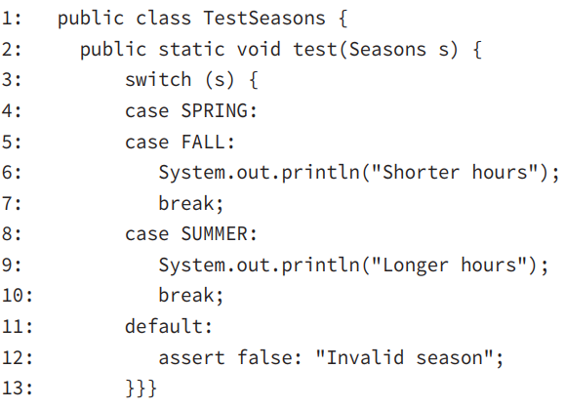
6-Working with Assertions
6-3) Using Assertions
Because the value of s on line 3 can only be SPRING, SUMMER, or FALL, and the switch statement has a case for all three of these outcomes, we can assert that line 12 is not reachable. This example is typical of when to use an assertion. We know that WINTER is not a choice because it is not in the enum. If this situation ever changes, the assertion will tell us about it. Notice that if it does, an AssertionError is thrown because the boolean is false.

Slide 81
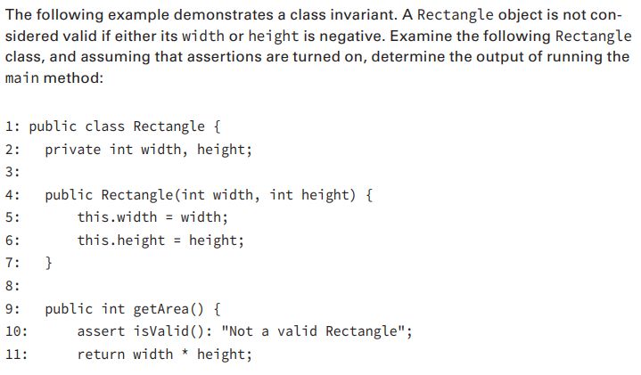
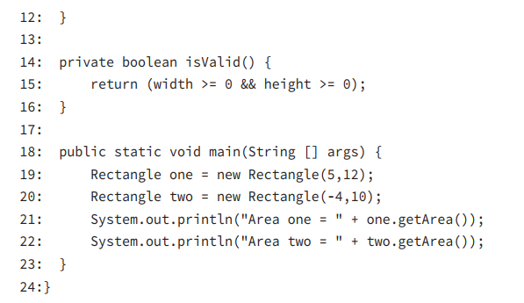
6-Working with Assertions
6-3) Using Assertions

Slide 82
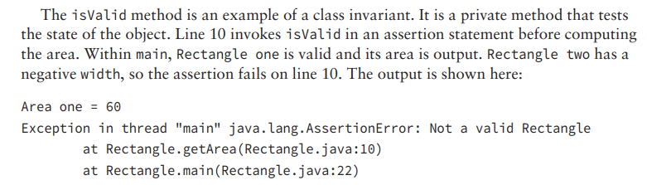
6-Working with Assertions
6-3) Using Assertions

Slide 83
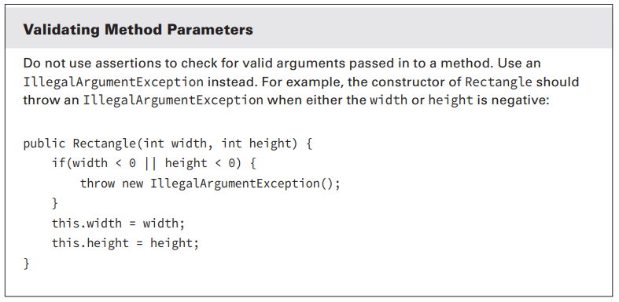
6-Working with Assertions
6-3) Using Assertions

Slide 84
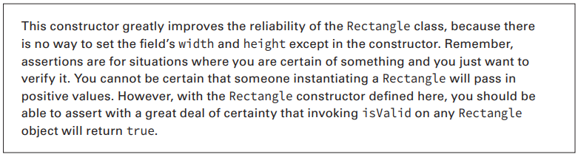
6-Working with Assertions
6-3) Using Assertions
Assertions are used for debugging purposes, allowing you to verify that something that you think is true during the coding phase is actually true at runtime.

